Slide 1
Dashboards & Stories
Using the Global Superstore dataset
CSC105
Prof. Earl

Slide 2
Table of Contents/Agenda
Creating a Basic Dashboard
Creating a Story
Slide 3
Slide 14

Slide 3
Creating a Basic Dashboard

Slide 4
Creating a Basic Dashboard
Click the icon to create a new dashboard. Name it Initial Superstore Analysis. Go to the Dashboard drop-down and Show Title.
Notice these Dashboard options at the lower-left. You should always think about this before starting your Dashboard. We will leave it set to Desktop, but often Laptop is a good choice also. “Automatic” is OK sometimes, but not if you want to have floating legends (which we will show today), since these will move around as the screen resizes under the Automatic setting.

Slide 5
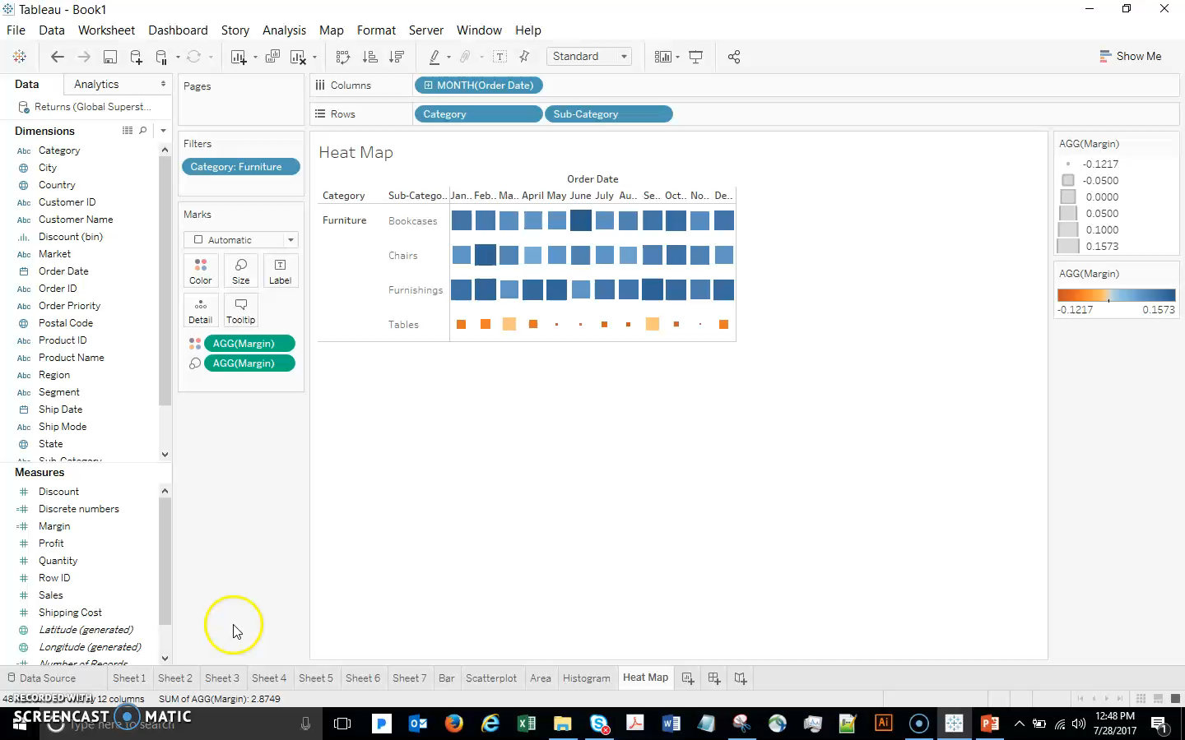
Creating a Basic Dashboard

Slide 6
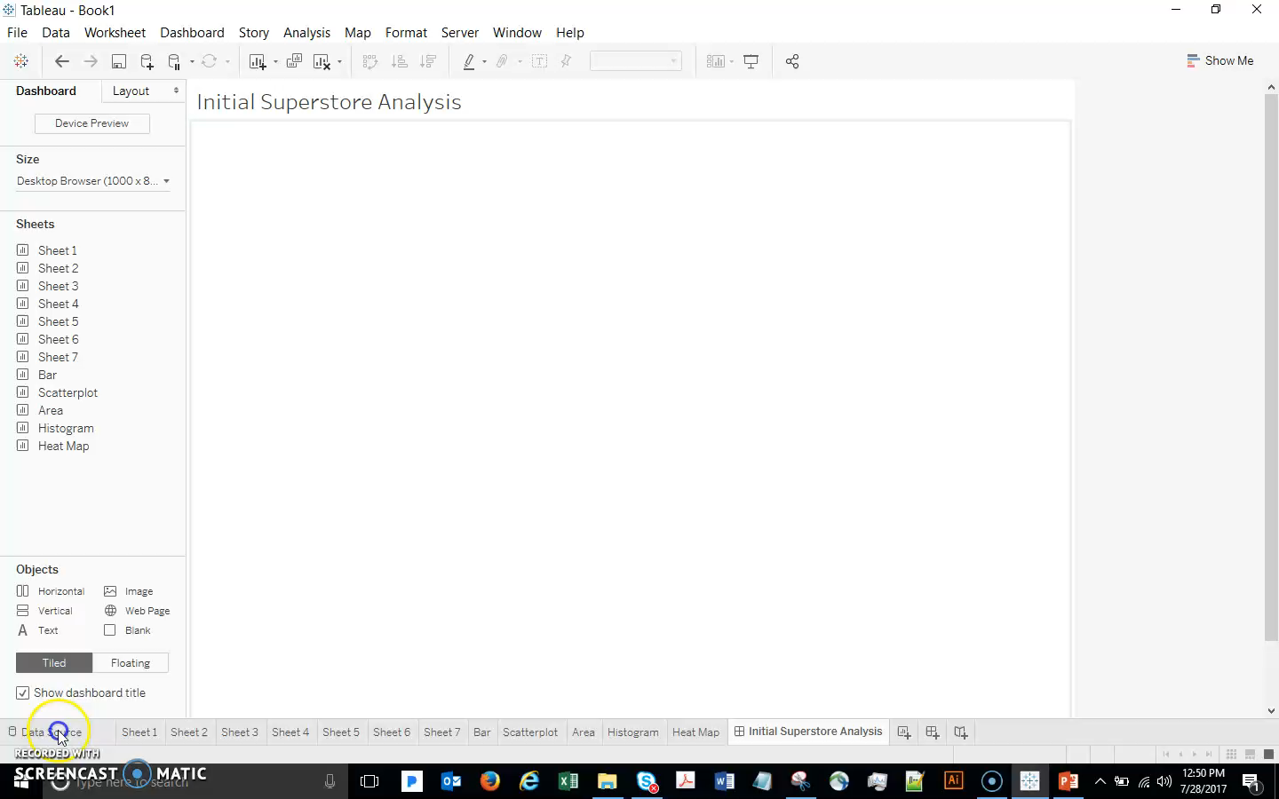
Creating a Basic Dashboard
Before populating this new dashboard, let’s add a Segment filter to the Scatterplot worksheet, and Show Filter. Now I am ready to populate my dashboard.
Drag in the Bar, add the Scatterplot below it, and add the Histogram on the lower right.

Slide 7
Creating a Basic Dashboard
Now let’s explore some options to enhance this basic dashboard.
Float the Profit color legend over the Bar Chart (Press shift+ drag to float it easily).
Float the Segment color legend over the Scatterplot.
Set the Segment filter to a single-value drop down.
Let’s have a closer look at that Segment filter. Notice that when I make changes to it, it only changes the worksheet that it was tied to. What if I want the entire dashboard to update based on my selection?

Slide 8
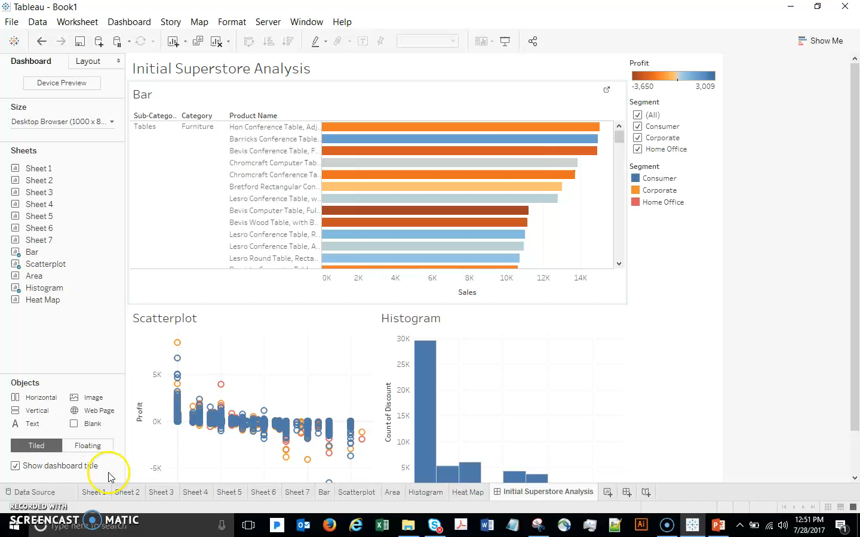
Creating a Basic Dashboard

Slide 9
Creating a Basic Dashboard
Select the menu on the Segment filter, select Apply to Worksheets….All Using This Data Source.
Make a couple of Segment selections to demonstrate how the change applies to the entire dashboard, finish with “All” categories selected.

Slide 10
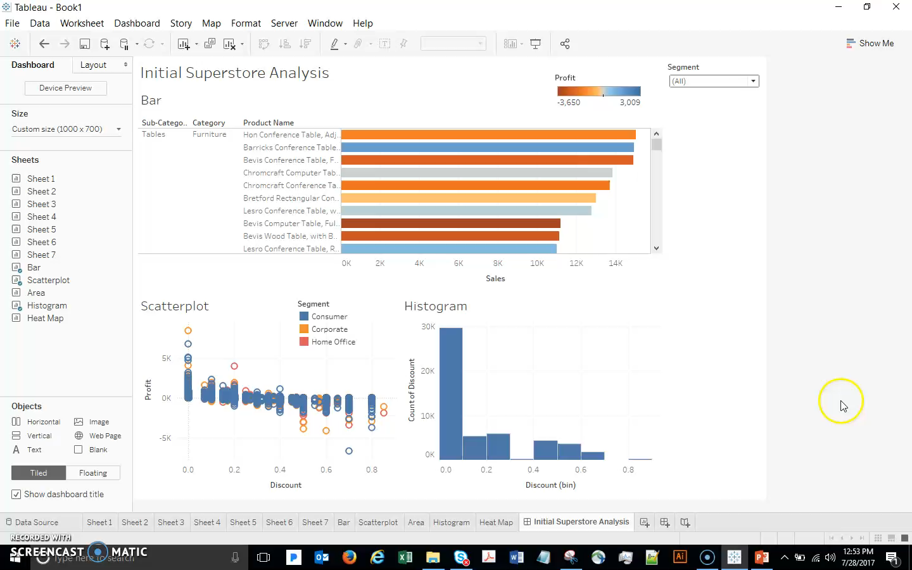
Creating a Basic Dashboard

Slide 11
Creating a Basic Dashboard
In addition to interacting with drop down filters like this, we can also use the worksheets themselves as filters. For example, I’d like to zero in on the different discount levels:
Select the ‘use as a filter’ icon on the Histogram (next to the drop-down arrow).
Click a few histogram bars and discuss

Slide 12
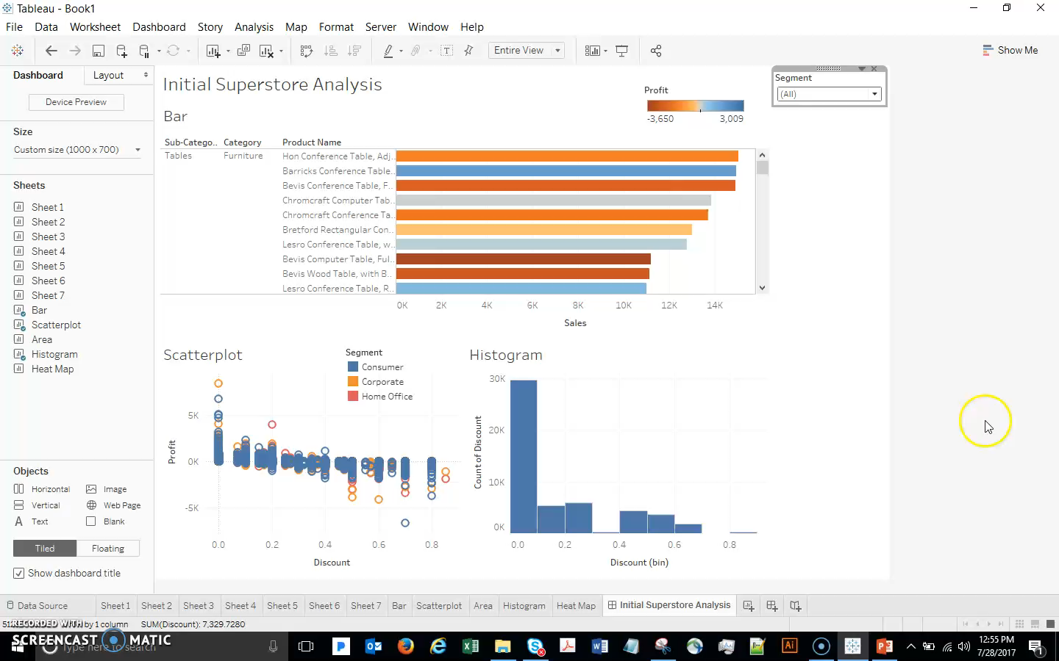
Creating a Basic Dashboard

Slide 13
Creating a Story

Slide 14
Creating a Story
Now click the New Story icon, and demonstrate how sheets or dashboards can be dragged in, captions written, etc. to develop a sequential walk through your analysis. Our current Tableau file might not be ideal for creating a Story, since we did a number of unrelated analyses, but this gives you an idea of what a Story can do – it is very powerful and simple!

Slide 15
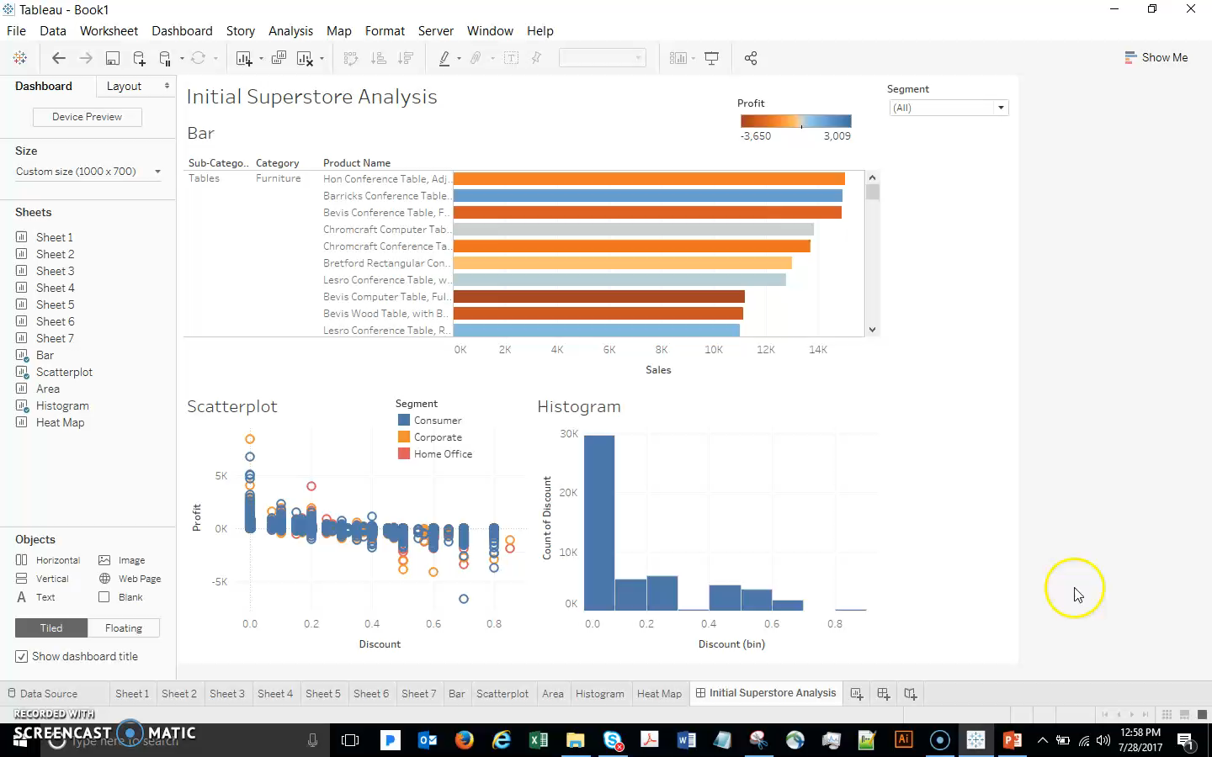
Creating a Story

